Slide 1



Cyber Kill Chain
Eng. Mahmoud Hassan

Slide 2
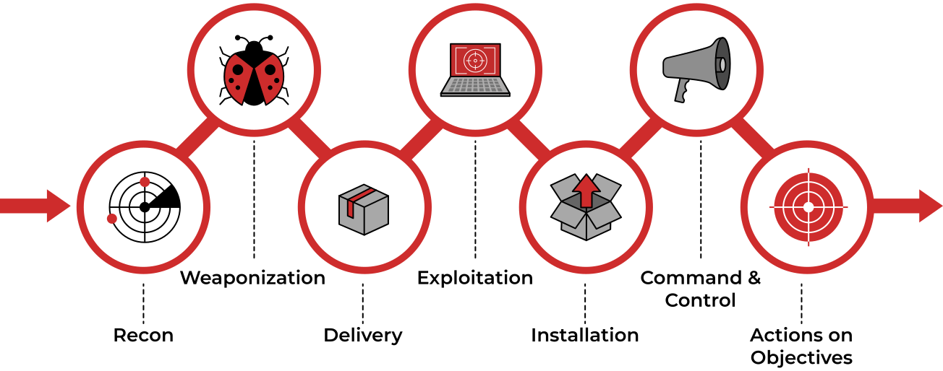
Cyber Kill Chain

Slide 3

Actions on Objectives (Exfiltration)
The Actions on Objectives Phase:
The Actions on Objectives phase is the final stage of the Cyber Kill Chain, where the attacker has successfully gained access to the target system or network and now focuses on achieving their end goals.
What the Attacker Can Do in This Phase?
Collecting Credentials: The attacker steals usernames and passwords of employees or administrators.
Example:
They can use tools like Mimikatz to extract passwords from the system’s memory.
2. Internal Reconnaissance: The attacker gathers additional information about the company’s internal network.
Example:
They interact with internal software to discover additional vulnerabilities that can be exploited.

Slide 4
Actions on Objectives (Exfiltration)
What the Attacker Can Do in This Phase?
3. Collecting and Exfiltrating Sensitive Data: The attacker collects sensitive data such as financial information, customer data, or trade secrets.
Example:
They transfer this data to an external server they control.
4. Deleting Backups and Shadow Copies:
Shadow Copy is a Microsoft technology that automatically creates backup copies of files or volumes.
The attacker deletes these backups to prevent the victim from recovering data after the attack.
Example:
The attacker uses tools like vssadmin to delete shadow copies.

Slide 5
Actions on Objectives (Exfiltration)
What the Attacker Can Do in This Phase?
5. Destroying or Corrupting Data: The attacker modifies or destroys data as part of the attack.
Example:
They can encrypt files using ransomware or permanently delete them.

Slide 6



Thank you
+201116735630
mahmoudhassan2947@gmail.com
www.linkedin.com/in/mahmoud-hassan-b4400b1b7

